Slide 1





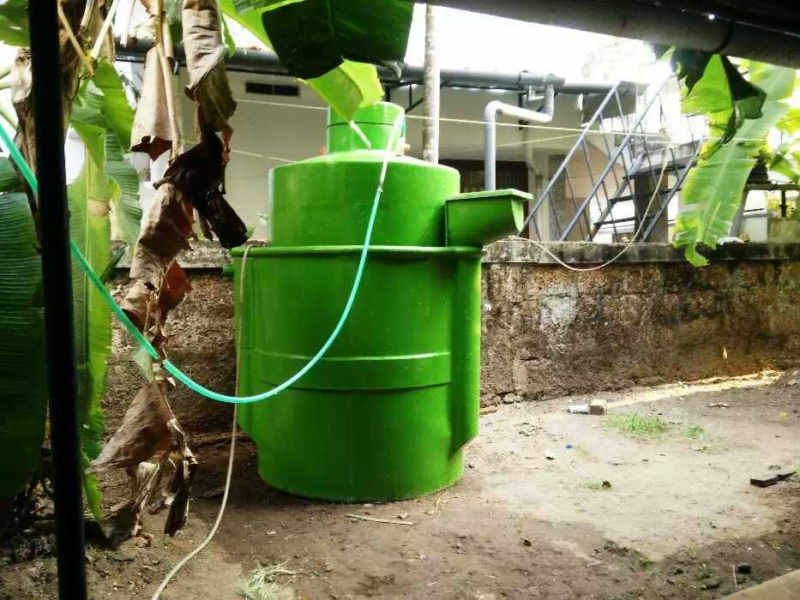


BIOFULES

Slide 2




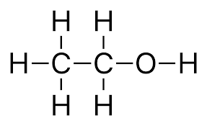
WHAT ARE BIOFULES
Biofuels are fuels made from renewable biological resources, such as plant materials or waste. They are an alternative to traditional fossil fuels, such as oil and gas, and are seen as a way to reduce the environmental impact of transportation and other energy-intensive sectors.

Slide 3
WHY ARE BIOFULES IMPORTANT
Reducing greenhouse gas emissions: Biofuels have the potential to reduce greenhouse gas emissions compared to fossil fuels. This is because the carbon released during their combustion is offset by the carbon absorbed during the growth of the plants used to make them. This makes biofuels a more sustainable and environmentally friendly alternative to fossil fuels.
Promoting energy security: Biofuels can help reduce dependence on foreign oil and promote energy security, as they can be produced domestically from locally grown crops or waste materials.
Supporting rural development: Biofuel production can provide economic benefits to rural communities by creating jobs and income opportunities for farmers and other workers in the biofuel supply chain.
Diversifying energy sources: Biofuels offer a way to diversify energy sources and reduce reliance on a single type of fuel. This can increase energy security and reduce vulnerability to price fluctuations and supply disruptions.

Slide 4
TYPES OF BIOFULES
Ethanol: Ethanol is a type of alcohol made from crops such as corn, sugarcane, and wheat. It is commonly blended with gasoline to produce a fuel that can be used in vehicles.
Biodiesel: Biodiesel is made from vegetable oils, animal fats, or recycled cooking oil. It can be used as a substitute for diesel fuel in vehicles, generators, and other equipment.

Slide 5
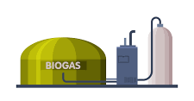

TYPES OF BIOFULES
Biogas: Biogas is a renewable energy source produced by the anaerobic digestion of organic matter such as animal waste, food scraps, and sewage. It can be used to generate electricity, heat buildings, and power vehicles.
Cellulosic biofuels: Cellulosic biofuels are made from non-food crops or waste materials such as agricultural residues, forestry waste, and municipal solid waste. These materials are broken down into sugars and then converted into biofuels using various technologies.

Slide 6
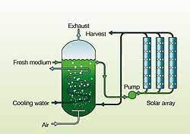
TYPES OF BIOFULES
Algae-based biofuels: Algae-based biofuels are made from algae, which can grow in a variety of environments including ponds, lakes, and even wastewater. Algae can be converted into oil that can be refined into a variety of biofuels.

Slide 7
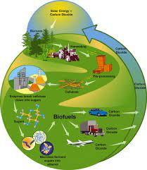
PRODUCTION
Feedstock preparation: The raw material (feedstock) is prepared for processing, which may involve cleaning, sorting, and chopping or shredding the material.
Conversion: The feedstock is converted into biofuels through various processes, which can include fermentation, transesterification, gasification, or pyrolysis, among others. For example, ethanol can be produced by fermenting sugars from crops such as corn, sugarcane, or wheat, while biodiesel can be produced by transesterifying vegetable oils or animal fats.
Purification: The biofuel is purified to remove impurities and improve its quality. This may involve distillation, filtration, or other separation techniques.

Slide 8
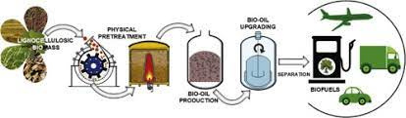
PRODUCTION
Blending: The biofuel may be blended with other fuels, such as gasoline or diesel, to meet specific requirements and standards.
Distribution and use: The biofuel is transported to distribution facilities and then to end-users, such as transportation or industrial sectors, where it is used as a fuel.

Slide 9
ADVANTAGE OF BIOFULES
Reduced greenhouse gas emissions: Biofuels have the potential to reduce greenhouse gas emissions compared to fossil fuels. This is because the carbon released during their combustion is offset by the carbon absorbed during the growth of the plants used to make them. In general, biofuels have lower carbon intensity and emit fewer pollutants such as particulate matter and sulfur dioxide.
Energy security: Biofuels can help reduce dependence on foreign oil and promote energy security, as they can be produced domestically from locally grown crops or waste materials. This can reduce the volatility of fuel prices and increase the resilience of energy systems to supply disruptions.
Rural development: Biofuel production can provide economic benefits to rural communities by creating jobs and income opportunities for farmers and other workers in the biofuel supply chain. This can support sustainable agriculture and help reduce poverty in rural areas.

Slide 10
DISADVANTAGE OF BIOFULES
Land use and food security: Biofuel production can compete with food production for land and other resources, which can drive up food prices and exacerbate food insecurity, particularly in developing countries. This competition can also lead to deforestation, which can have negative impacts on biodiversity, soil health, and climate change.
Water use: Biofuel production can be water-intensive, particularly in areas with limited water resources. This can lead to competition for water with other uses, such as irrigation, drinking water, and ecological needs, and potentially exacerbate water scarcity and conflicts.
Sustainability and lifecycle emissions: Biofuels can have different sustainability impacts depending on the feedstock, production process, and other factors. For example, some biofuels can have high emissions from land use change, fertilizer use, and other factors, which can offset or even exceed the emissions reductions from the biofuel itself. It's important to ensure that biofuels are produced sustainably and with a lifecycle perspective, taking into account all the environmental, social, and economic impacts.

Slide 11
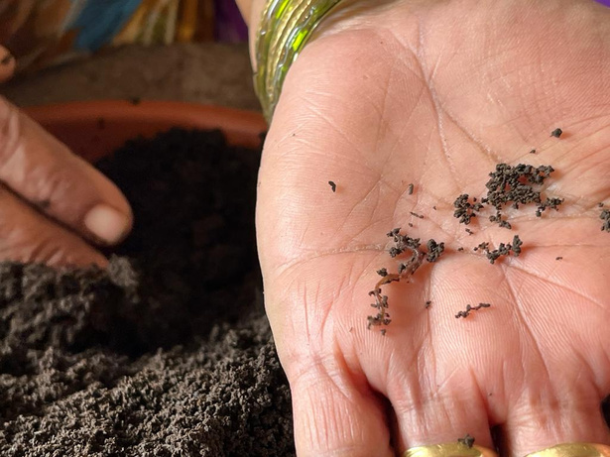
THANK YOU

